Slide 1



Noida Institute of Engineering and Technology, Greater Noida
Design Patterns
Unit: III
Design Patterns
ACSE0514
Prateek Mathur
Assistant Professor
IT Department
B.Tech 5th Sem

Slide 2
Syllabus
Structural Pattern Part-I, Adapter
Bridge
Composite
Structural Pattern Part-II, Decorator Pattern
Façade Pattern
Flyweight Pattern
Proxy Pattern
UNIT III
STRACTURAL DESIGN PATTERNS

Slide 3
Application Areas Of Design Patterns
DESIGN PATTERNS CAN BE USED IN:
Real time web analytics
Digital Advertising
E-Commerce
Publishing
Massively Multiplayer Online Games
Massively Multiplayer Online Games
Project Management & Collaboration
Real time Monitoring Services
Live Charting and Graphing
Live Charting and Graphing

Slide 4
Course Objectives
The Course Objective Is To
Familiarize the student with Techniques for designing reusable combinations of Java classes.
Organizing their cooperation to produce modular and maintainable Java programs.
Study to speed up the development process by providing well-tested, proven development/design paradigms.
Select a specific design pattern for the solution of a given design problem.

Slide 5
Course Outcome (COs)
After completion of this course students will be able to :-
CO 1
Construct a design consisting of a collection of modules.
CO 2
Construct a design consisting of a collection of modules.
CO 3
Distinguish between different categories of design patterns.
CO 4
Ability to understand and apply common design patterns to incremental/iterative development.
CO 5
Ability to identify appropriate patterns for design of given problem and Design the software using Pattern Oriented Architectures.

Slide 6
Program Outcome (POs)
Engineering Graduate Students will be able to :-
PO 1
Engineering Knowledge
PO 2
Problem Analysis
PO 3
Design/Development of solutions
PO 4
Conduct Investigations of complex problems
PO 5
Modern tool usage
PO 6
The engineer and society

Slide 7
Program Outcome (POs)
Engineering Graduate Students will be able to :-
PO 7
Environment and sustainability
PO 8
Ethics
PO 9
Individual and teamwork
PO 10
Communication
PO 11
Project management and finance
PO 12
Life-long learning

Slide 8
Course Outcome (Cos) & Program Outcome (POs) Mapping
CO.K | PO1 | PO2 | PO3 | PO4 | PO5 | PO6 | PO7 | PO8 | PO9 | PO10 | PO11 | PO12
CO1 | 2 | 2 | 2 | 3 | 3 | - | - | - | - | - | - | -
CO2 | 3 | 2 | 3 | 2 | 3 | - | - | - | - | - | - | -
CO3 | 3 | 2 | 3 | 2 | 3 | - | - | - | - | - | - | -
CO4 | 3 | 2 | 3 | 2 | 3 | - | - | - | - | - | - | -
CO5 | 3 | 2 | 3 | 3 | 3 | - | - | - | - | - | - | -
AVG | 2.8 | 2.0 | 2.8 | 2.4 | 3.0 | - | - | - | - | - | - | -

Slide 9
Program Specific Outcome (PSOs)
PSO 1
Understand to shows relationships and interactions between classes or objects of a pattern.
PSO 2
Study to speed up the development process by providing well-tested, proven development
PSO 3
Select a specific design pattern for the solution of a given design problem
PSO 4
Create a catalogue entry for a simple design pattern whose purpose and application is understood.

Slide 10
Course Outcome (Cos) & Program Outcome (POs) Mapping
CO.K | PO1 | PO2 | PO3 | PO4
CO1 | 3 | - | - | -
CO2 | 3 | 3 | - | -
CO3 | 3 | 3 | - | -
CO4 | 3 | 3 | - | -
CO5 | 3 | 3 | - | -

Slide 11
Program Educational Objectives (PEOs)
PEO 1
To have an excellent scientific and engineering breadth so as to comprehend, analyze, design and provide sustainable solutions for real-life problems using state-of-the-art technologies.
PEO 2
To have a successful career in industries, to pursue higher studies or to support entrepreneurial endeavors and to face the global challenges.
PEO 3
To have an effective communication skills, professional attitude, ethical values and a desire to learn specific knowledge in emerging trends, technologies for research, innovation and product development and contribution to society.
PEO 4
To have life-long learning for up-skilling and re-skilling for successful professional career as engineer, scientist, entrepreneur and bureaucrat for betterment of society.

Slide 12
Prerequisite / Recap
Object Oriented Analysis and Design.
Data structures and algorithms.
Programming Language (C++ or Java)
Decent Problem-Solving Skills Required

Slide 13
Video Links To Describe Design Pattern
https://youtu.be/rI4kdGLaUiQ?list=PL6n9fhu94yhUbctIoxoVTrklN3LMwTCmd
https://youtu.be/v9ejT8FO-7I?list=PLrhzvIcii6GNjpARdnO4ueTUAVR9eMBpc
https://youtu.be/VGLjQuEQgkI?list=PLt4nG7RVVk1h9lxOYSOGI9pcP3I5oblbx
https://youtu.be/C_oPLDaSy-8
https://youtu.be/NU_1StN5Tkk

Slide 14
Content
Introduction
Objective
MCQ
Glossary Questions
Expected Questions In Final Exam
Recap Of Third Unit
Structural Design Patterns
Adapter Design Pattern
Bridge Design Pattern
Composite Design Pattern
Decorator Design Pattern
Facade Design Pattern
Flyweight Design Pattern
Proxy Design Pattern
Assignment

Slide 15
Unit III : Introduction
Adapter Pattern
Bridge Pattern
Composite Pattern
Decorator Pattern
Flyweight Pattern
Proxy Pattern
Facade Pattern
Structural Pattern Part 1
Structural Pattern Part II

Slide 16
Objective Unit III
Definitions of terms and concepts
The idea of a pattern
The origins of all design patterns
How Patterns Work in software design
Scope of development activity: applications, toolkits, frameworks

Slide 17
Topic Objective
Topic: Structural Pattern (Adapter)
In this topic, the students will gain , The idea of a Structural design pattern, It concerned with how classes and objects can be composed, to form larger structures. The structural design patterns simplifies the structure by identifying the relationships.

Slide 18
Structural Design Patterns
Structural design patterns are concerned with how classes and objects can be composed, to form larger structures.
01
The structural design patterns simplifies the structure by identifying the relationships.
02
These patterns focus on, how the classes inherit from each other and how they are composed from other classes.
03
structural design patterns are design patterns that ease the design by identifying a simple way to realize relationships among entities. Examples of Structural Patterns include Adapter pattern, Bridge, Composite etc.

Slide 19
Structural patterns (Adapter Pattern)
ADAPTER PATTERN
An Adapter Pattern says that just "convert the interface of a class into another interface that a client wants".
In other words, to provide the interface according to client requirement while using the services of a class with a different interface.
The Adapter Pattern is also known as Wrapper.
ADVANTAGE OF ADAPTER PATTERN
It allows two or more previously incompatible objects to interact.
It allows reusability of existing functionality.

Slide 20
Usage Of Structural patterns (Adapter Pattern)
1.
2.
When you want to create a reusable class that cooperates with classes which don't have compatible interfaces.
3.
When you want to create a reusable class that cooperates with classes which don't have compatible interfaces.
When an object needs to utilize an existing class with an incompatible interface.

Slide 21
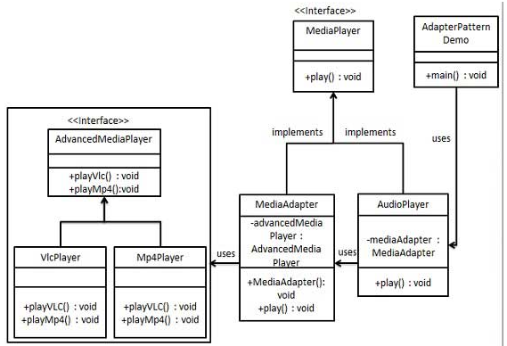
Structure of Adapter Design Pattern

Slide 22
Implementation of Adapter Design Pattern
We have a Media Player interface and a concrete class Audio Player implementing the Media Player interface. Audio Player can play mp3 format audio files by default.
We are having another interface Advanced Media Player and concrete classes implementing the Advanced Media Player interface. These classes can play vlc and mp4 format files.
We want to make Audio Player to play other formats as well. To attain this, we have created an adapter class Media Adapter which implements the Media Player interface and uses Advanced Media Player objects to play the required format.
AudioPlayer uses The adapter class Media Adapter passing it the desired audio type without knowing the actual class which can play the desired format. Adapter Pattern Demo, our demo class will use Audio Player class to play various formats.

Slide 23
Topic Objective
Topic: Bridge Design Pattern
In this topic, the students will gain , The idea of a Structural design pattern, It concerned with how classes and objects can be composed, to form larger structures. "decouple the functional abstraction from the implementation so that the two can vary independently".

Slide 24
Bridge Design Pattern
A Bridge Pattern says that just "decouple the functional abstraction from the implementation so that the two can vary independently".
Bridge is used when we need to decouple an abstraction from its implementation so that the two can vary independently.
We want to make Audio Player to play other formats as well. To attain this, we have created an adapter class Media Adapter which implements the Media Player interface and uses Advanced Media Player objects to play the required format.
This type of design pattern comes under structural pattern as this pattern decouples implementation class and abstract class by providing a bridge structure between them.

Slide 25
Bridge Design Pattern
Advantage of Bridge Pattern
It enables the separation of implementation from the interface.
It improves the extensibility.
It allows the hiding of implementation details from the client.
Usage of Bridge Pattern
When you don't want a permanent binding between the functional abstraction and its implementation.
When both the functional abstraction and its implementation need to extended using sub-classes.
It is mostly used in those places where changes are made in the implementation does not affect the clients.

Slide 26
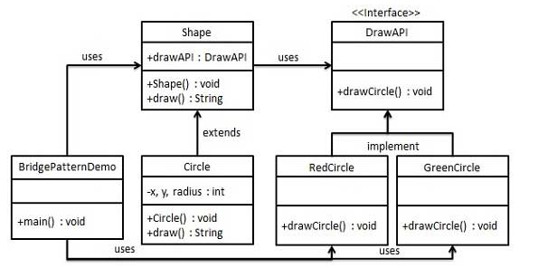
Structure Of Bridge Design Pattern

Slide 27
Implementation of Bridge Design Pattern
1
We are demonstrating use of
2
We have a Draw API
3
Shape is an abstract class
Bridge pattern via following
example in which a circle can
be drawn in different colors
using same abstract class
method but different bridge
implementer classes.
interface which is acting
as a bridge implementer
and concrete classes
Red Circle, Green Circle
implementing the Dra
API interface.
and will use object of
Draw API. Bridge Pattern Demo, our demo class will use Shape class to draw different colored circle.

Slide 28
Topic Objective
Topic: Composite Design Pattern
In this topic, the students will gain , The idea of a Structural design pattern, A Composite Pattern says that just "allow clients to operate in generic manner on objects that may or may not represent a hierarchy of objects".

Slide 29
Composite Design Pattern
A Composite Pattern says that just "allow clients to operate in generic manner on objects that may or may not represent a hierarchy of objects".
Composite pattern is used where we need to treat a group of objects in similar way as a single object. Composite pattern composes objects in term of a tree structure to represent part as well as whole hierarchy.
This type of design pattern comes under structural pattern as this pattern creates a tree structure of group of objects.
This pattern creates a class that contains group of its own objects. This class provides ways to modify its group of same objects.

Slide 30
Composite Design Pattern
Advantage of Composite Design Pattern
It defines class hierarchies that contain primitive and complex objects.
It makes easier to you to add new kinds of components.
It provides flexibility of structure with manageable class or interface.
Usage of Composite Design Pattern
When you want to represent a full or partial hierarchy of objects.
When the responsibilities are needed to be added dynamically to the individual objects without affecting other objects. Where the responsibility of object may vary from time to time.

Slide 31
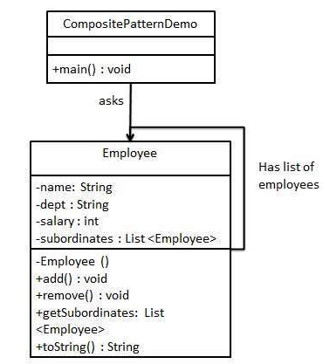
Structure Of Composite Design Pattern

Slide 32
Implementation of Composite Design Pattern
1
This pattern creates a class that contains group of its own objects. This class provides ways to modify its group of same objects.
2
We are demonstrating use of composite pattern via following example in which we will show employees hierarchy of an organization.
3
We have a class Employee which acts as composite pattern actor class. CompositePatternDemo, our demo class will use Employee class to add department level hierarchy and print all employees.

Slide 33
Topic Objective
Topic: Structural Pattern II (Decorator Pattern)
In this topic, the students will gain , The idea of a Structural design pattern, A Decorator Pattern says that just "attach a flexible additional responsibilities to an object dynamically".

Slide 34
Decorator Design Pattern
A Decorator Pattern says that just "attach a flexible additional responsibilities to an object dynamically".
The Decorator Pattern uses composition instead of inheritance to extend the functionality of an object at runtime. The Decorator Pattern is also known as Wrapper.
Decorator pattern allows a user to add new functionality to an existing object without altering its structure.
This pattern creates a decorator class which wraps the original class and provides additional functionality keeping class methods signature intact.

Slide 35
Decorator Design Pattern
Advantage of Decorator Design Pattern
It provides greater flexibility than static inheritance.
It enhances the extensibility of the object, because changes are made by coding new classes. It simplifies the coding by allowing you to develop a series of functionality from targeted classes instead of coding all of the behavior into the object.
Usage of Decorator Design Pattern
When you want to transparently and dynamically add responsibilities to objects without affecting other objects.
When you want to add responsibilities to an object that you may want to change in future. Extending functionality by sub-classing is no longer practical.

Slide 36
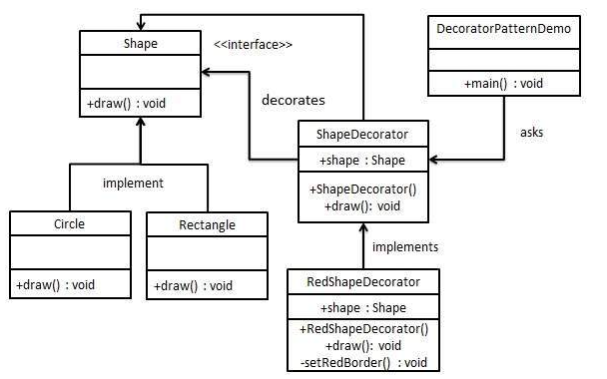
Structure Of Decorator Design Pattern

Slide 37
Implementation
1
We are demonstrating the use of decorator pattern via following example in which we will decorate a shape with some color without alter shape class.
2
We're going to create a Shape interface and concrete classes implementing the Shape interface. We will then create an abstract decorator class Shape Decorator implementing the Shape interface and having Shape object as its instance variable.
3
4
Decorator Pattern Demo, our demo class will use Red Shape Decorator to decorate Shape objects.
Red Shape Decorator is concrete class implementing Shape Decorator.

Slide 38
Topic Objective
Topic: Facade Pattern
In this topic, the students will gain , The idea of a Structural design pattern, A Facade Pattern says that just "just provide a unified and simplified interface to a set of interfaces in a subsystem, therefore it hides the complexities of the subsystem from the client".

Slide 39
Facade Design Pattern
Facade Pattern says that just "just provide a unified and simplified interface to a set of interfaces in a subsystem, therefore it hides the complexities of the subsystem from the client".
In other words, Facade Pattern describes a higher-level interface that makes the sub-system easier to use.
Practically, every Abstract Factory is a type of Facade.
Facade pattern hides the complexities of the system and provides an interface to the client using which the client can access the system.

Slide 40
Facade Design Pattern
Advantage of Facade Design Pattern
It shields the clients from the complexities of the sub-system components.
It promotes loose coupling between subsystems and its clients.
Usage of Facade Design Pattern
When you want to provide simple interface to a complex sub-system.
When several dependencies exist between clients and the implementation classes of an abstraction.

Slide 41
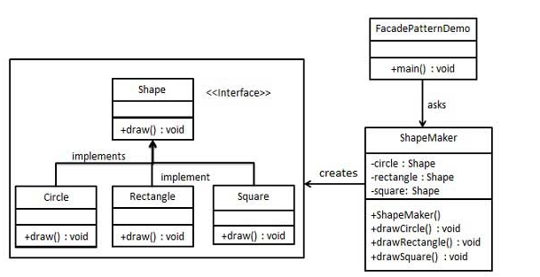
Structure Of Facade Design Pattern

Slide 42
Implementation Of Façade Design Pattern
1
We are going to create a Shape interface and concrete classes implementing the Shape interface. A facade class Shape Maker is defined as a next step.
2
Shape Maker class uses the concrete classes to delegate user calls to these classes. Façade Pattern Demo, our demo class, will use Shape Maker class to show the results.
3
This pattern involves a single class which provides simplified methods required by client and delegates calls to methods of existing system classes.

Slide 43
Topic Objective
Topic: Flyweight Pattern
In this topic, the students will gain , The idea of a Structural design pattern, A Flyweight Pattern says that just "to reuse already existing similar kind of objects by storing them and create new object when no matching object is found".

Slide 44
Flyweight Design Pattern
A Flyweight Pattern says that just "to reuse already existing similar kind of objects by storing them and create new object when no matching object is found".
Flyweight pattern is primarily used to reduce the number of objects created and to decrease memory footprint and increase performance. This type of design pattern comes under structural pattern as this pattern provides ways to decrease object count thus improving the object structure of application.

Slide 45
Flyweight Design Pattern
Advantage of Flyweight Design Pattern
It reduces the number of objects.
It reduces the amount of memory and storage devices required if the objects are persisted
Usage of Flyweight Design Pattern
When an application uses number of objects
When the storage cost is high because of the quantity of objects.
When the application does not depend on object identity.

Slide 46
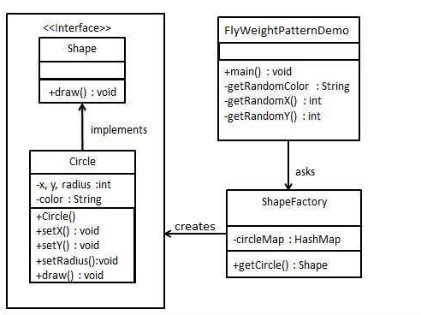
Structure Of Flyweight Design Pattern

Slide 47
Implementation Of Flyweight Design Pattern
1
We are going to create a Shape interface and concrete class Circle implementing the Shape interface. A factory class ShapeFactory is defined as a next step.
2
ShapeFactory has a HashMap of Circle having key as color of the Circle object. Whenever a request comes to create a circle of particular color to ShapeFactory, it checks the circle object in its HashMap, if object of Circle found, that object is returned otherwise a new object is created, stored in hashmap for future use, and returned to client.
3
FlyWeightPatternDemo, our demo class, will use ShapeFactory to get a Shape object. It will pass information (red / green / blue/ black / white) to ShapeFactory to get the circle of desired color it needs.

Slide 48
Topic Objective
Topic: Proxy Pattern
In this topic, the students will gain , The idea of a Structural design pattern, According to GoF, a Proxy Pattern "provides the control for accessing the original object".

Slide 49
Proxy Design Pattern
Simply, proxy means an object representing another object.According to GoF, a Proxy Pattern "provides the control for accessing the original object".
we can perform many operations like hiding the information of original object, on demand loading etc.Proxy pattern is also known as Surrogate or Placeholder.
In proxy pattern, a class represents functionality of another class. This type of design pattern comes under structural pattern.
In proxy pattern, we create object having original object to interface its functionality to outer world.

Slide 50
Proxy Design Pattern
Advantage of Proxy Design Pattern
It provides the protection to the original object from the outside world.
Usage of Proxy Design Pattern
It can be used in Virtual Proxy scenario---Consider a situation where there is multiple database call to extract huge size image.
It can be used in Protective Proxy scenario---It acts as an authorization layer to verify that whether the actual user has access the appropriate content or not.

Slide 51
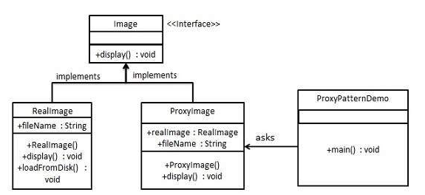
Structure Of Proxy Design Pattern

Slide 52
Implementation Of Proxy Design Pattern
1
We are going to create an Image interface and concrete classes implementing the Image interface. ProxyImage is a proxy class to reduce memory footprint of RealImage object loading.
2
ProxyPatternDemo, our demo class, will use ProxyImage to get an Image object to load and display as it needs.
3
In proxy pattern, a class represents functionality of another class. This type of design pattern comes under structural pattern.

Slide 53
Daily Quiz
Q 1 - You want to minimize development cost by reusing methods? Which design pattern would you choose?
Adapter Pattern
Singleton Pattern
Delegation pattern
Immutable Pattern
Q 2 - Which design pattern defines one-to-many dependency among objects?
Singleton pattern
Facade Pattern
Observer pattern
Factory method pattern

Slide 54
Daily Quiz
Q 3 - Which design pattern suggest multiple classes through which request is passed and multiple but only relevant classes carry out operations on the request.
Singleton pattern
Chain of responsibility pattern
State pattern
Bridge pattern
Q 4 - Most user interface design patterns fall with in one of ____ categories of patterns.
5
10
25
100

Slide 55
Assignment
What are Design Patterns in Java? What are the types of design patterns in Java.
What are the Structural Patterns and What Is Façade Pattern.
What Is Flyweight Design Pattern.
Explain Facade Pattern in Java.
Explain the Proxy pattern.

Slide 56
MCQ
Design patterns can be classified in _______ categories.
1
2
3
4
2. Which design patterns are specifically concerned with communication between objects?
Creational Patterns
Structural Patterns
Behavioral Patterns
J2EE Patterns

Slide 57
MCQ
3. Which design pattern provides a single class which provides simplified methods required by client and delegates call to those methods?
Adapter pattern
Builder pattern
Facade pattern
Prototype pattern
4. Which design pattern suggests multiple classes through which request is passed and multiple but only relevant classes carry out operations on the request?
Singleton pattern
Chain of responsibility pattern
State pattern
Bridge pattern

Slide 58
Glossary Questions
What are design patterns?
How are design patterns categorized?
Explain the benefits of design patterns in Java.
Describe the factory pattern.
Differentiate ordinary and abstract factory design patterns.
What do you think are the advantages of builder design patterns?
How is the bridge pattern different from the adapter pattern?
What is a command pattern?
Describe the singleton pattern along with its advantages and disadvantages.
What are anti patterns?

Slide 59
Expected Questions For Final Exam
What are design patterns?
How are design patterns categorized?
Explain the benefits of design patterns in Java.
Describe the factory pattern.
Differentiate ordinary and abstract factory design patterns.
What do you think are the advantages of builder design patterns?
How is the bridge pattern different from the adapter pattern?
What is a command pattern?
Describe the singleton pattern along with its advantages and disadvantages.
What are anti patterns?

Slide 60
Recap Of Third Unit
Till Now we understand, The idea of a Structural design pattern, It concerned with how classes and objects can be composed, to form larger structures. The structural design patterns simplifies the structure by identifying the relationships.
A Facade Pattern says that just "just provide a unified and simplified interface to a set of interfaces in a subsystem, therefore it hides the complexities of the subsystem from the client".
You also learn, a Proxy Pattern "provides the control for accessing the original object".
A Flyweight Pattern says that just "to reuse already existing similar kind of objects by storing them and create new object when no matching object is found".

